Slide 1
IoT Air Quality Project
Group member : Junho Jung, Duyong Chung , Qingyi Zhang

Slide 2
We measures indoor air quality and reveals the difference between indoor air and outdoor air compared to outdoor air quality provided by EPA. And making an IOT device that requires ventilation(air out) when the indoor air is bad.

Slide 3
The Reason Of Indoor Room Air Quality Test
Why do we need to know the indoor air quality?
To reduce the possibility of COVID-19 transmission.
To improve the life quality during the pandemic.
To provide the possible choice of staying home and getting out.
Ref. (MIT PAPER)
“Assessing the relationship between surface levels of PM2.5 and PM10 particulate matter impact on COVID-19 in Milan, Italy”

Slide 4
The Concept Of Air Quality Test
The component of this project:
The component of this project:
Items
Arduino , DHT22(Temperature & Humidity) , MQ-7(Gas) , Raspberry pi
SDS011 (Fine Particle PM 2.5~10.0)
How does it work?
The device can detect the general air quality
indoor and will compare it with the data collected from the government.

Slide 5
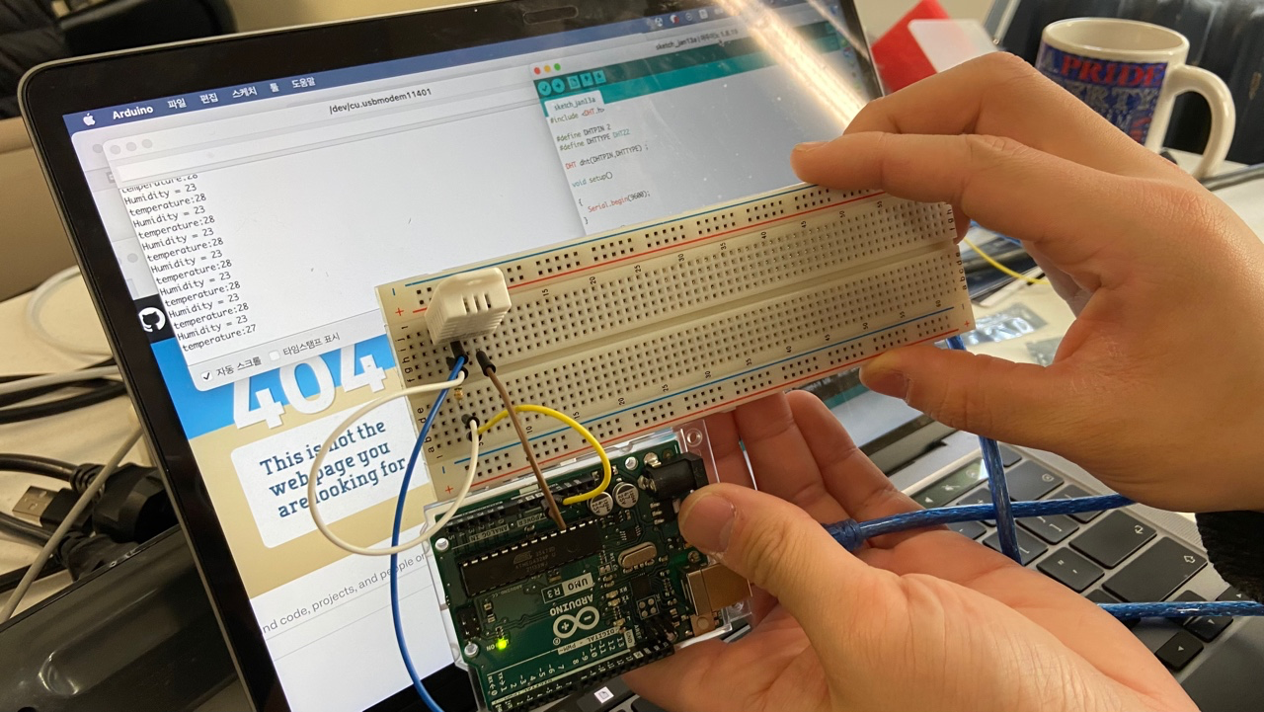
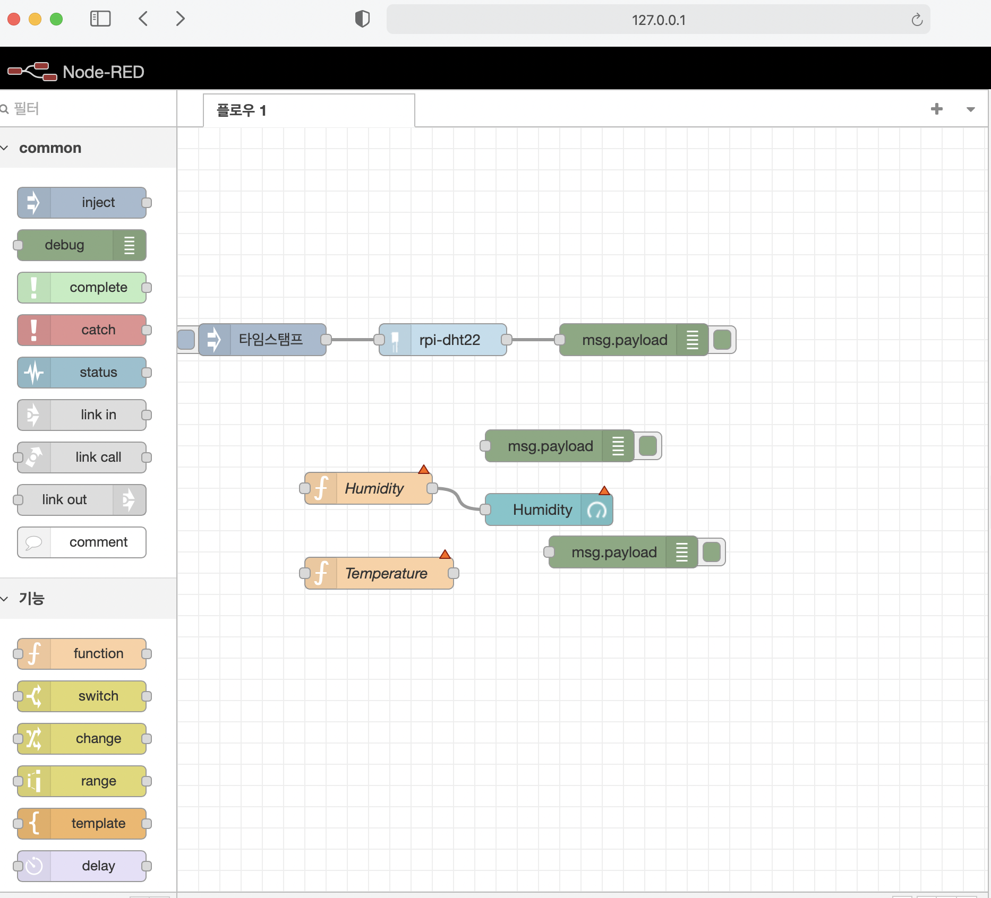
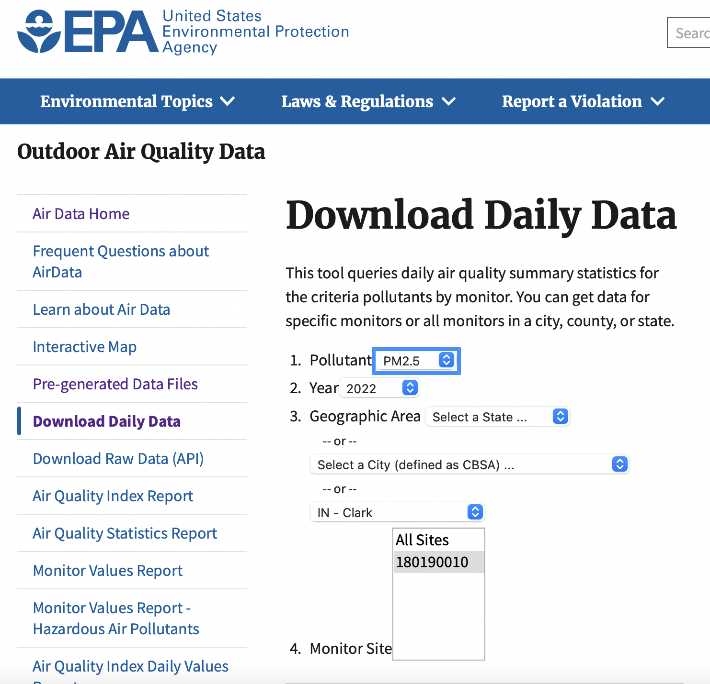
What we did in 2weeks
Testing humidity ,temperature sensor /Node- RED Testing /Download Daily Data(PM10,PM2.5, O3, NO2)

Slide 6
MileStone & Challenge
Node Red how to visualize the Our data and connecting?
Can we use only Raspberry pi without Arduino?
How to save our data after measuring ?

Slide 7



Our Team(little changed)
Duyong Chung
Junho Jung
Qingyi Zhang
Computer
Engineering
Computer
Engineering
Cyber Security CNIT

Slide 8
Thank you

